Slide 1
SWITCHING THEORY AND LOGIC DESIGN
UNIT-3
BY
S.SAGAR KRISHNA,
ASSISTANT PROFESSOR,
GAYATRI VIDYA PARISHAD COLLEG OF ENGINEERIN(A)

Slide 2
CARRY LOOK AHEAD ADDER
In Ripple Carry adder, the speed with which an addition can be performed is governed by the time required for the carries to propagate or ripple through all of the stages of the adder.
The carry look-ahead adder speeds up the process by eliminating this ripple carry delay. It examines all the input bits simultaneously and also generates the carry-in bits for all the stages simultaneously.

Slide 3

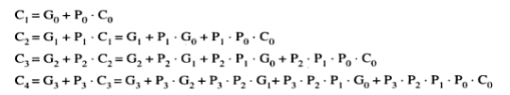
CARRY LOOK AHEAD ADDER
For the final sum and carry outputs of the nth stage, we get the following Boolean expressions.
Based on these , the expression for the carry-outs of various full adders are as follows,
C_{o}=Previous carry, P₀=A_{O} ⊕ B₀ , G₀ =A₀.B₀ , P₁=A₁ ⊕ B₁ , G₁ =A₁.B_{1 ,} P₂=A₂ ⊕ B₂ , G₁ =A₂.B_{2,} P₃=A₃ ⊕ B₃ , G₃ =A₃.B₃
The above equation tells that carry is dependent on inputs. More logic gates are required for implementing this design

Slide 4
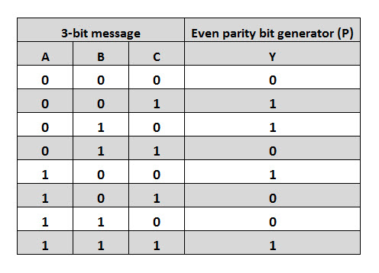
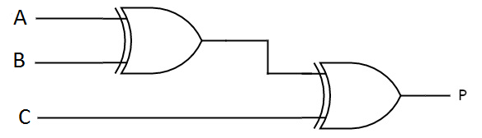
PARITY BIT GENERATOR
Here we can have even parity generator or odd parity generator
Even parity generator
Logic Diagram
This can be drawn by finding Boolean Expression
through 3 variable K-Map
Functional Table

Slide 5
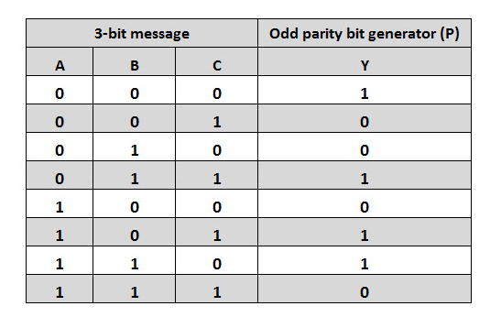
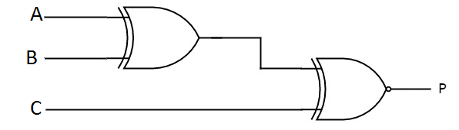
PARITY BIT GENERATOR
Odd parity generator
Logic Diagram
This can be drawn by finding Boolean Expression
through 3 variable K-Map
Functional Table

Slide 6
PROGRAMMABLE LOGIC DEVICES(PLD’s)
Contains an array of AND gates and OR gates
Advantages:
Low cost
Design a larger circuit
Reprogramming
(Modify the design)

Slide 7
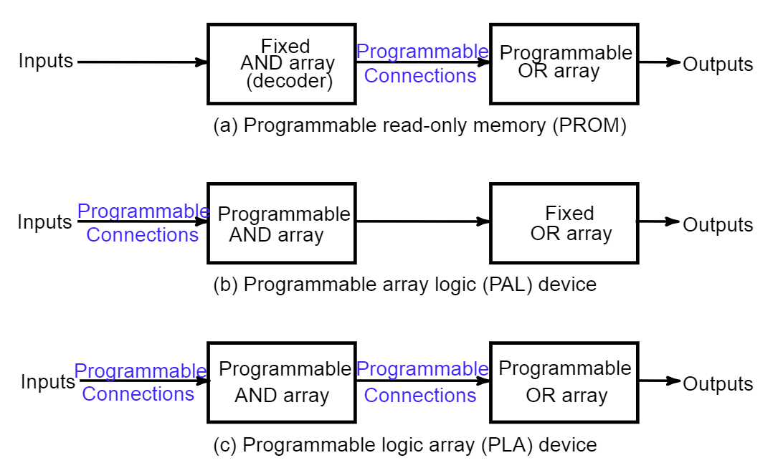
TYPES OF PLD’s

Slide 8
PROM
Contains an fixed AND array & Programmable OR array gates.
AND gate will generate 2^{n} product terms by using 2^{n} AND gates having n inputs each by using nx2^{n} decoder. So, this decoder generates ‘n’ min terms.
OR GATE: we can program any number of required product terms, since all the outputs of AND gates are applied as inputs to each OR gate. Therefore, the outputs of PROM will be in the form of sum of min terms

Slide 9
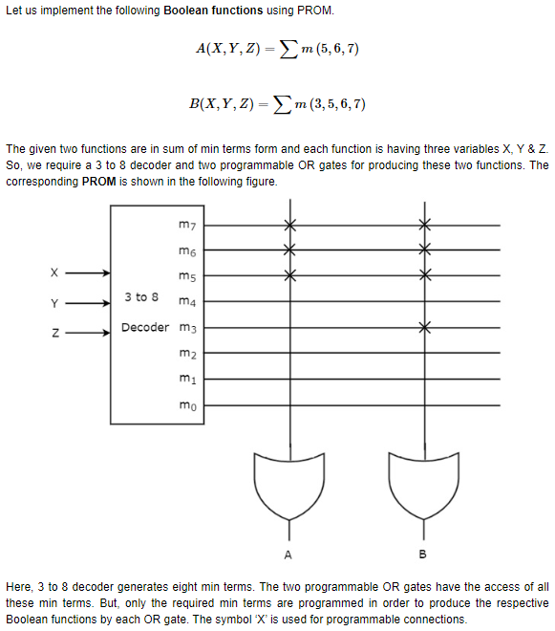
PROM

Slide 10
PAL
Contains an Programmable AND array & Fixed OR array gates.
Each AND gate has both normal and complemented inputs of variables. So, based on the requirement, we can program any of those inputs. So, we can generate only the required product terms by using these AND gates.
OR GATE: So, the number of inputs to each OR gate will be of fixed type. Hence, apply those required product terms to each OR gate as inputs. Therefore, the outputs of PAL will be in the form of sum of products form.

Slide 11
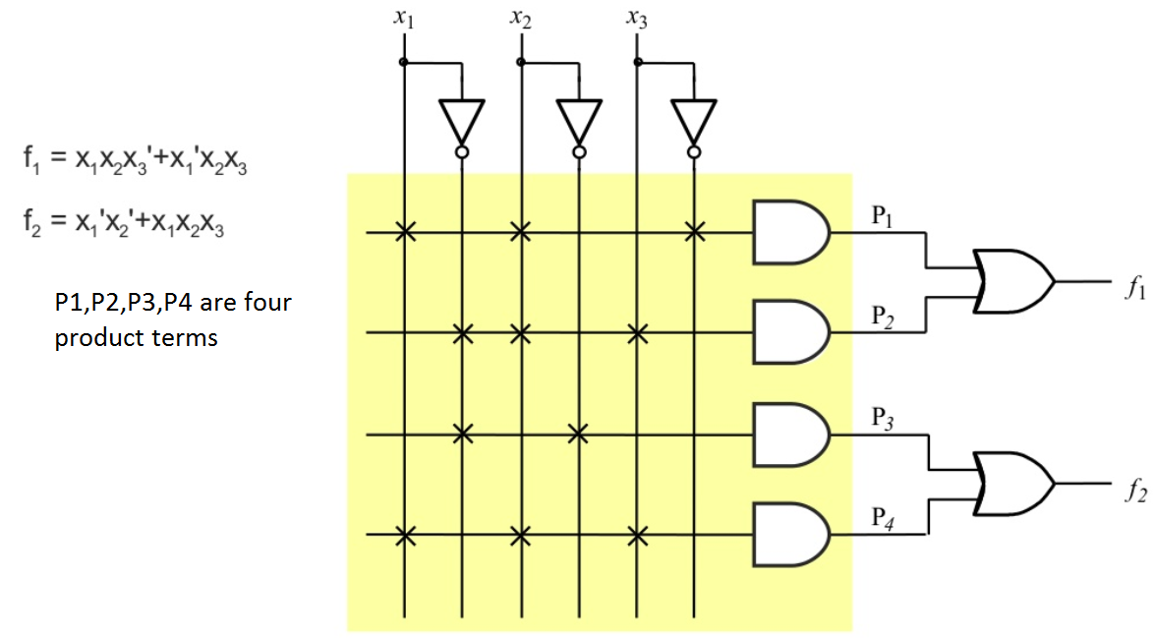
PAL

Slide 12
PLA
Contains an Programmable AND array & Programmable OR array gates.
Each AND gate has both normal and complemented inputs of variables. So, based on the requirement, we can program any of those inputs. So, we can generate only the required product terms by using these AND gates.
OR GATE: we can program any number of required product terms, since all the outputs of AND gates are applied as inputs to each OR gate. Therefore, the outputs of PLA will be in the form of sum of min terms

Slide 13
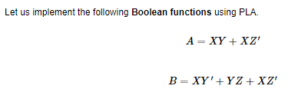
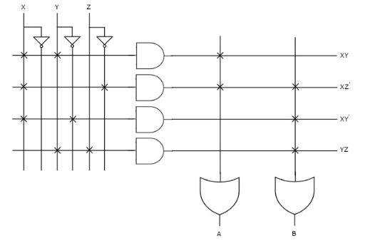
PLA

Slide 14
THANK YOU

